Slide 1
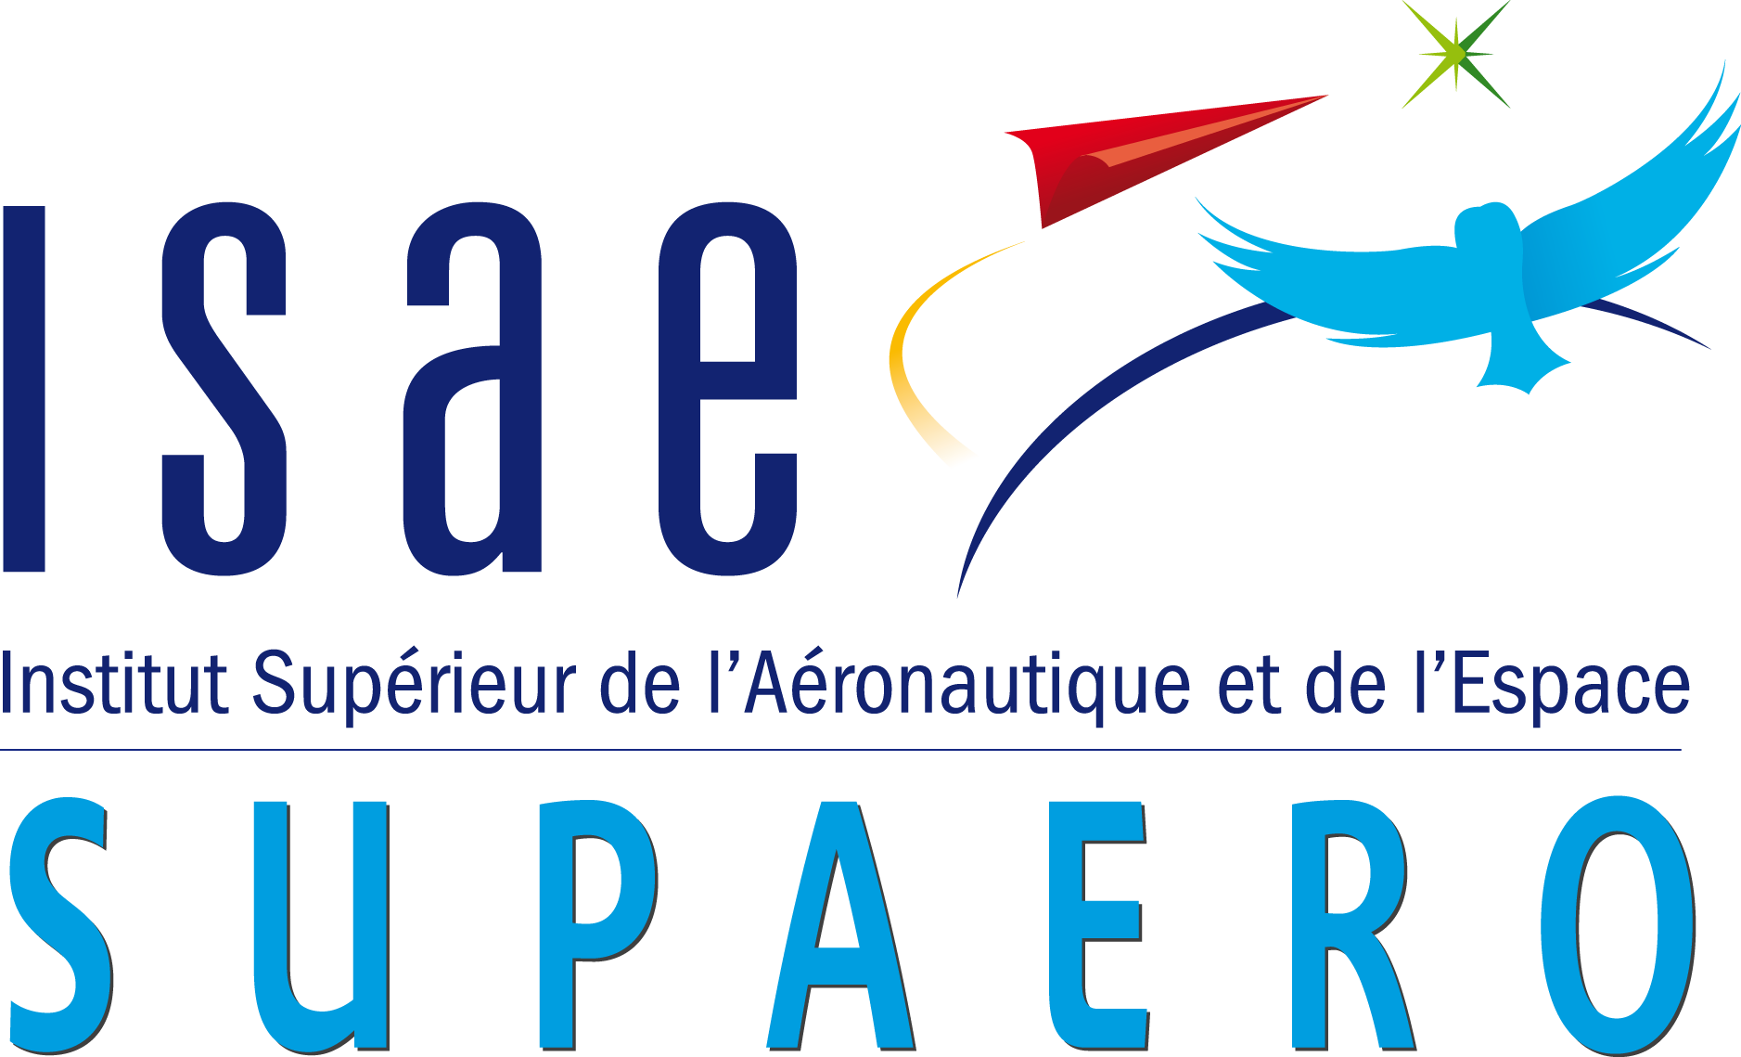

Autonomous Robotic Aerial Vehicle: ARAV Control in Complex Environments
Akash Sharma
Tutors:
R. Deepthimahanthi Y. Briere

Slide 2
About the Project
2 / 28

Slide 3
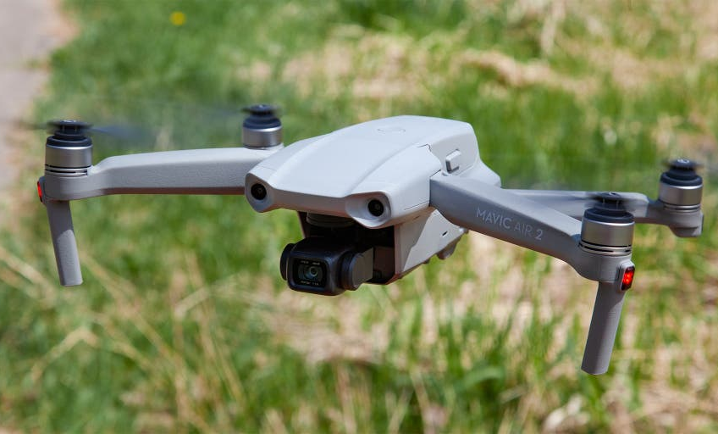
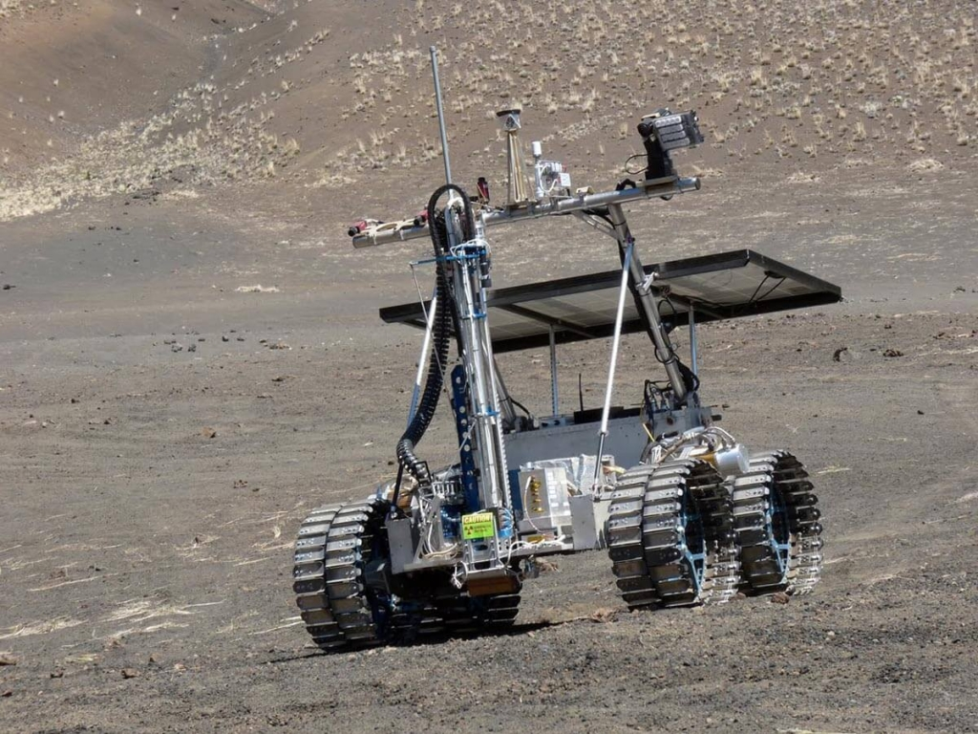

Background
Capable of covering large distances
Consumes more energy
Capable of traversing rough terrain
Does not consume a lot of energy
Cannot drive everywhere
Hybrid vehicle capable of performing both kinds of activities
Completely autonomous
3 / 28
Notes:
The vehicle is designed after merging the technology of UAVs and ground rovers.
Applications of UAVs- surveillance, exploration, delivery, topography mapping.
Applications of ground rovers - Space missions for collecting soil samples and analyzing the terrain. This is because they are designed to be functionally robust in order to be able to traverse rough and unforgiving terrains.

Slide 4
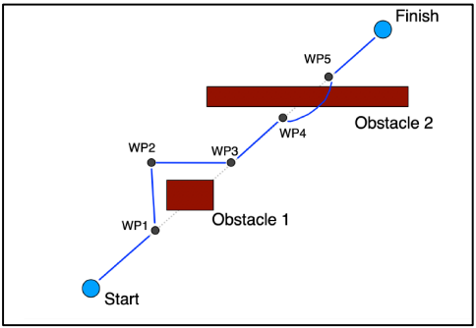
Main Goal
Create a vehicle capable of navigating across complex and uncertain environments filled with obstacles
Using 2 modes of transport available
Does this completely autonomously
Sample path with obstacles and waypoints
4 / 28

Slide 5
Simulation Environment
5 / 28

Slide 6
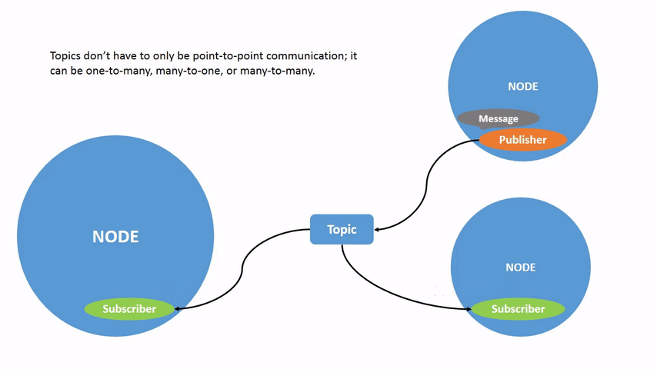
ROS Architecture
Point-to-point framework
Supports multiple languages simultaneously
Supports flexibility and reusability
6 / 28
Notes:
No need to speak about topics or publishers and subscribers.

Slide 7
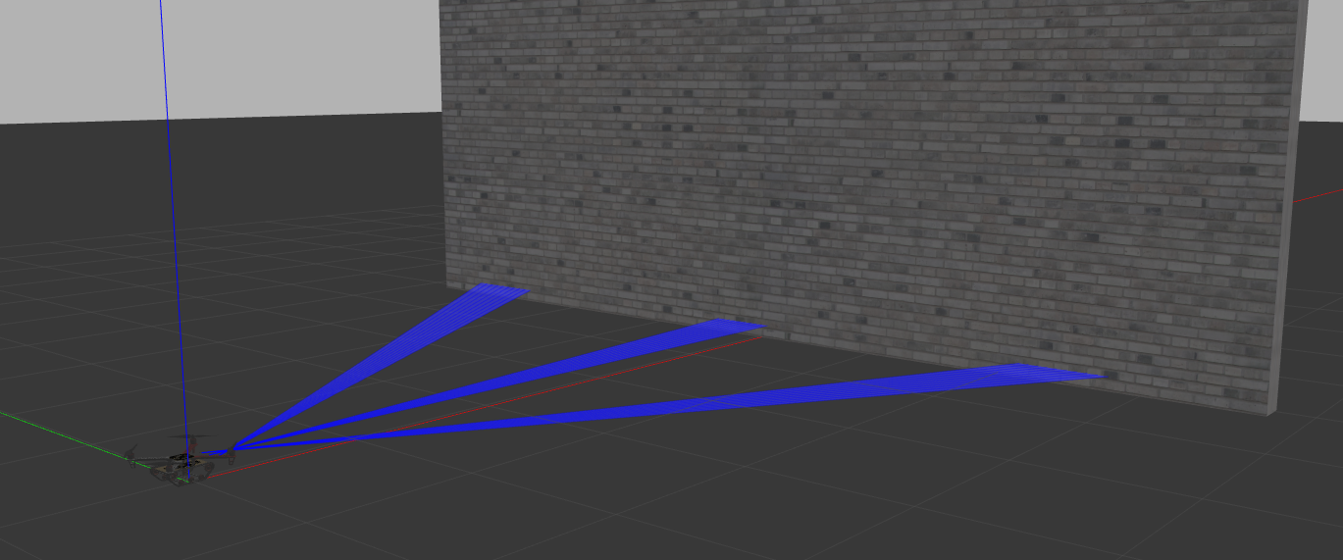
Gazebo
Compatible with ROS
Robust physics engine
Can simulate sensor feedback
OBSTACLE !!!
I see you...
7 / 28
Notes:
Noise in sensor feedback

Slide 8
Software Architecture
8 / 28

Slide 9

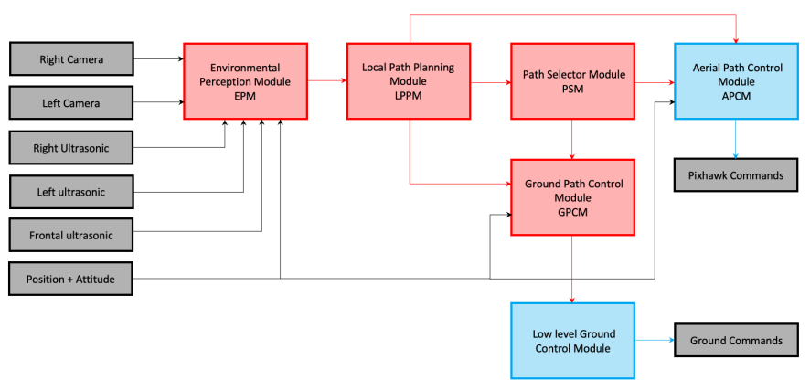
0
sensors
sensors
SOURCE: J. Bessa and A. Ceballos. Autonomous robotic aerial vehicle: S3 project report. March, 2022
9 / 28
Notes:
Make animations for stagewise explanation

Slide 10
Development Areas
Planned Improvements
10 / 28

Slide 11
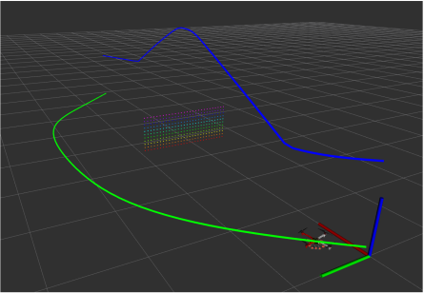
Path Planning Module
No possibility of hybrid paths
True objective of energy not minimized: Min. Length ≠ Min. Energy
Planning Control Module
Absence of an aerial PX4 controller
Preliminary ground controller
11 / 28

Slide 12
Path Planning Module Development & RRT*
12 / 28

Slide 13
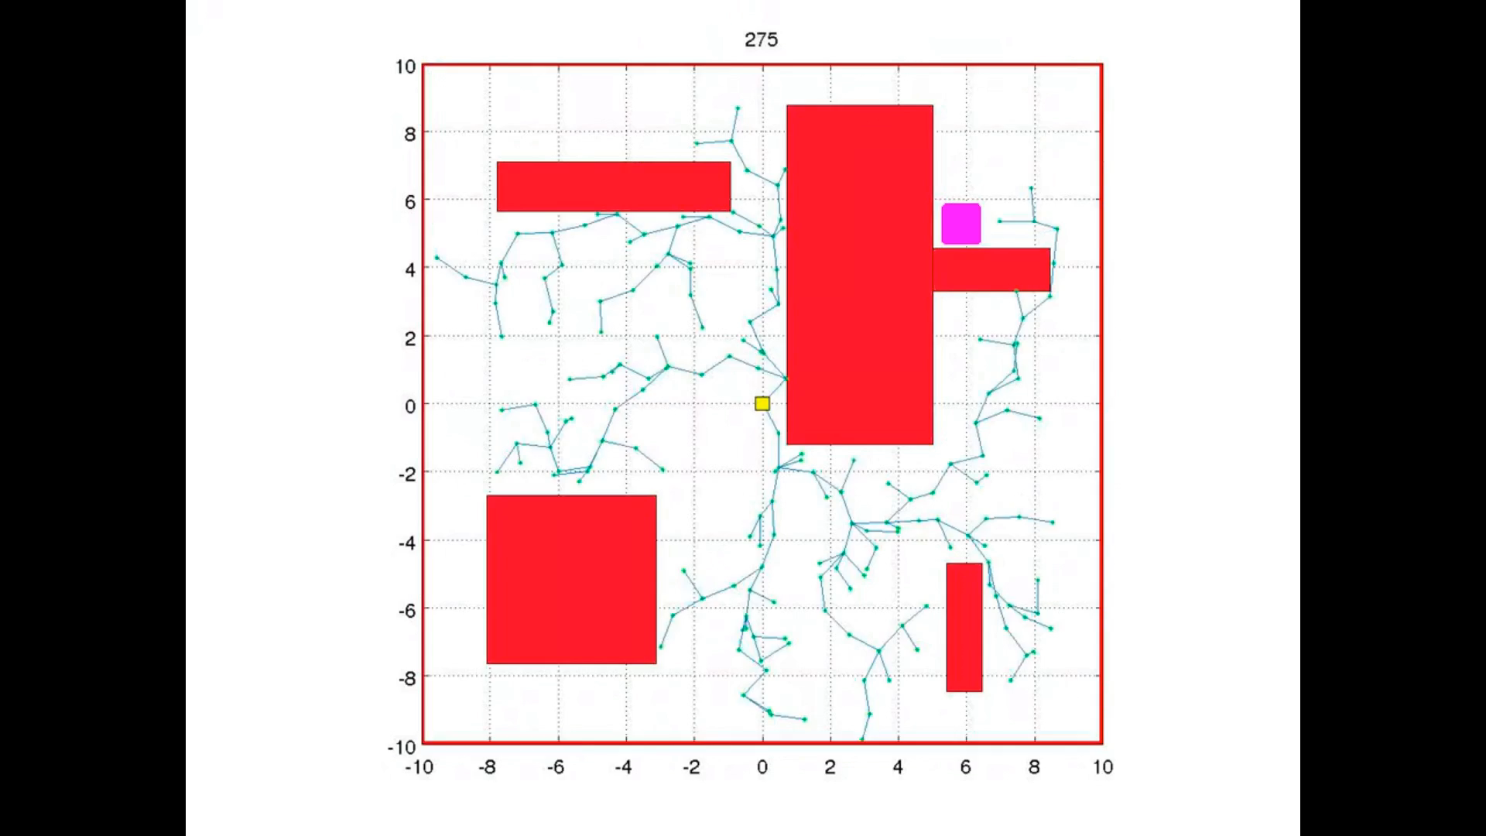
How RRT* works
Samples points randomly in a bounded space and connects them to create a tree structure
Once a path is created, subsequent sampled points cause the tree to branch out and refine the created path based on the optimization logic
Solution is asymptotically optimal
SOURCE: Open Motion Planning Library. url: https://ompl.kavrakilab.org/core/index.html
13 / 28

Slide 14
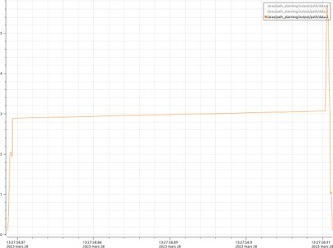
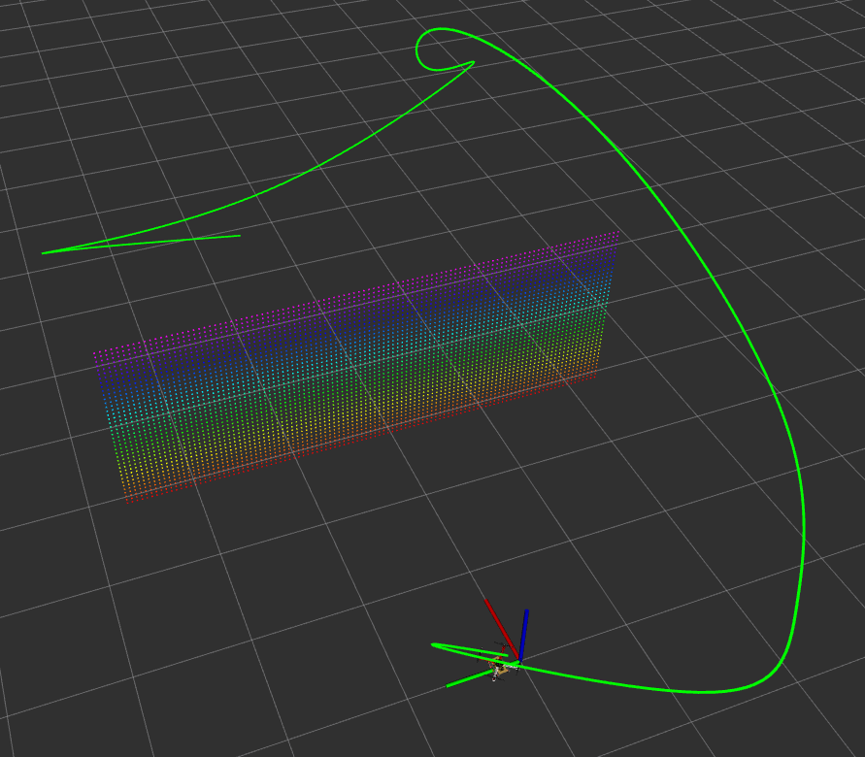
Mechanical Work Objective
14 / 28
If state.Z < 0.2
Statecost = 0.8
Else
Statecost = 2.0
Z vs. Time

Slide 15
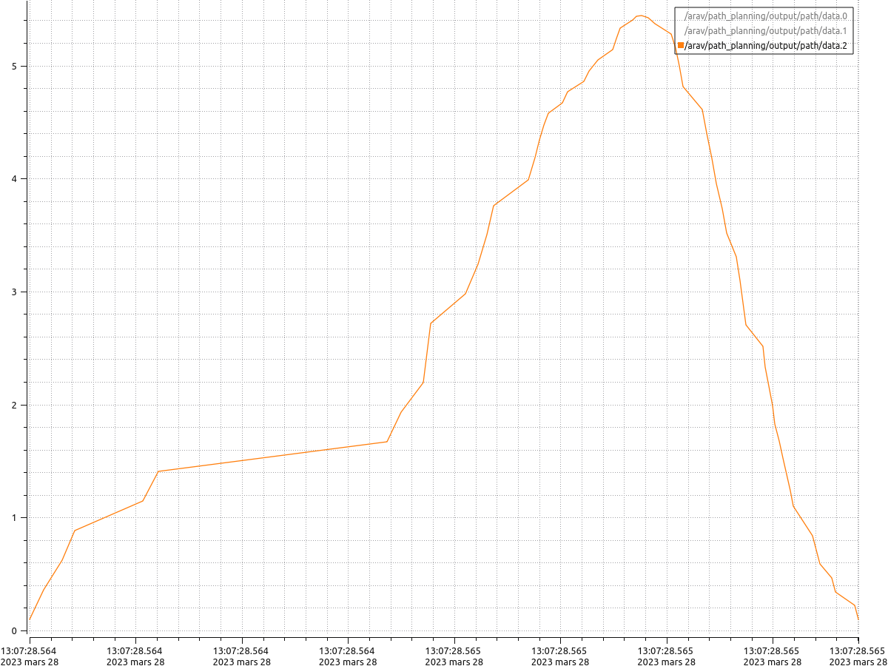
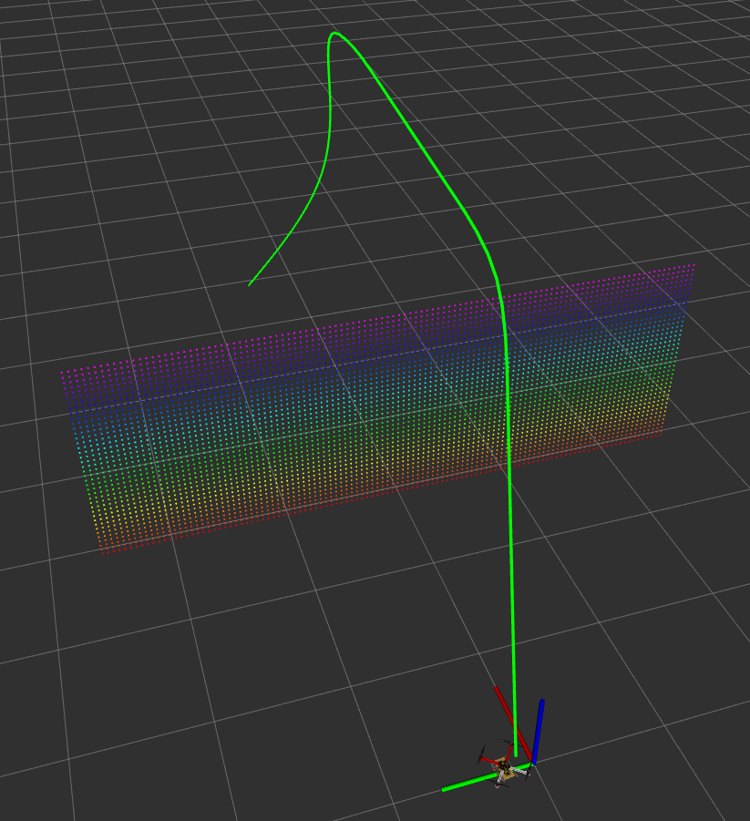
Custom Energy Objective
16 / 28
If state1.Z or state2.Z > 0.2
BatteryFactor = 2.0
Else
BatteryFactor = 0.8
Z vs. Time

Slide 16
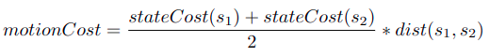
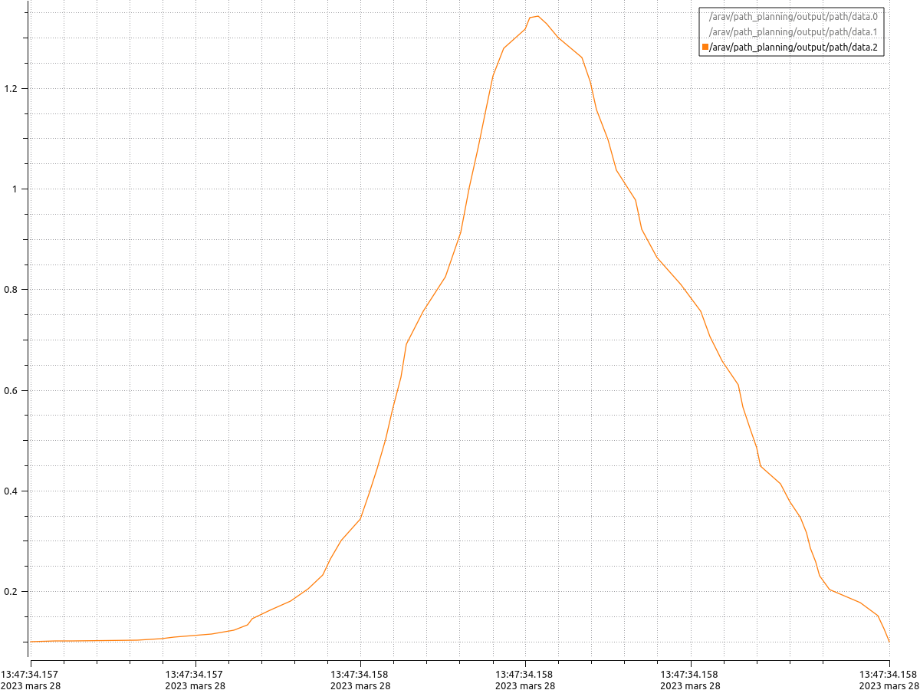
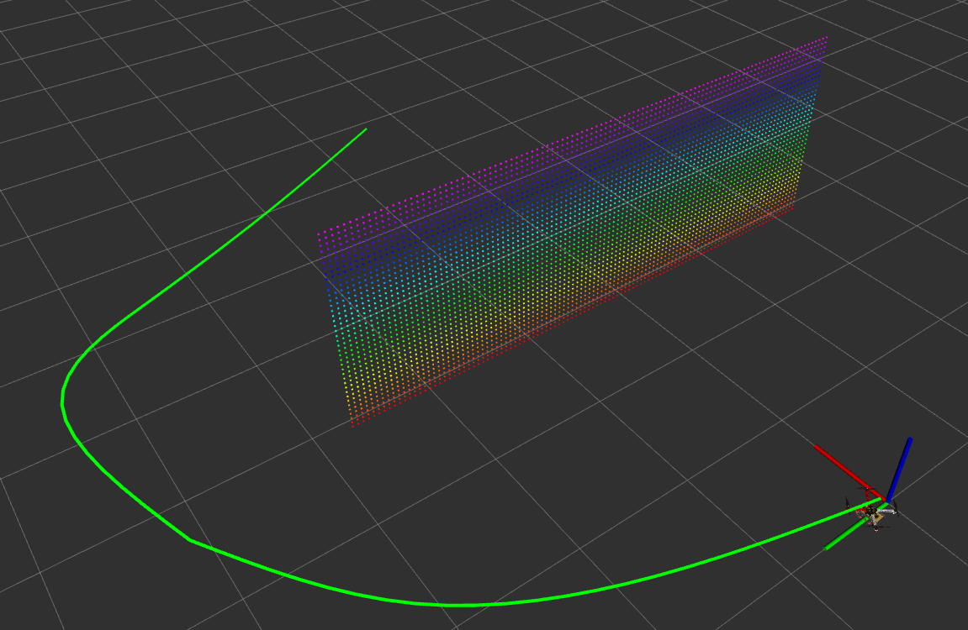
State Cost Integral Objective
15 / 28
If state.Z < 0.2
Statecost = 0.8
Else
Statecost = 2.0
Z vs. Time

Slide 17
Observation about RRT*
Probabilistically favors aerial points
So the path tends to be aerial at least in some parts
An exact solution is required but never found
17 / 28

Slide 18
Path Planning Module & A*
18 / 28

Slide 19
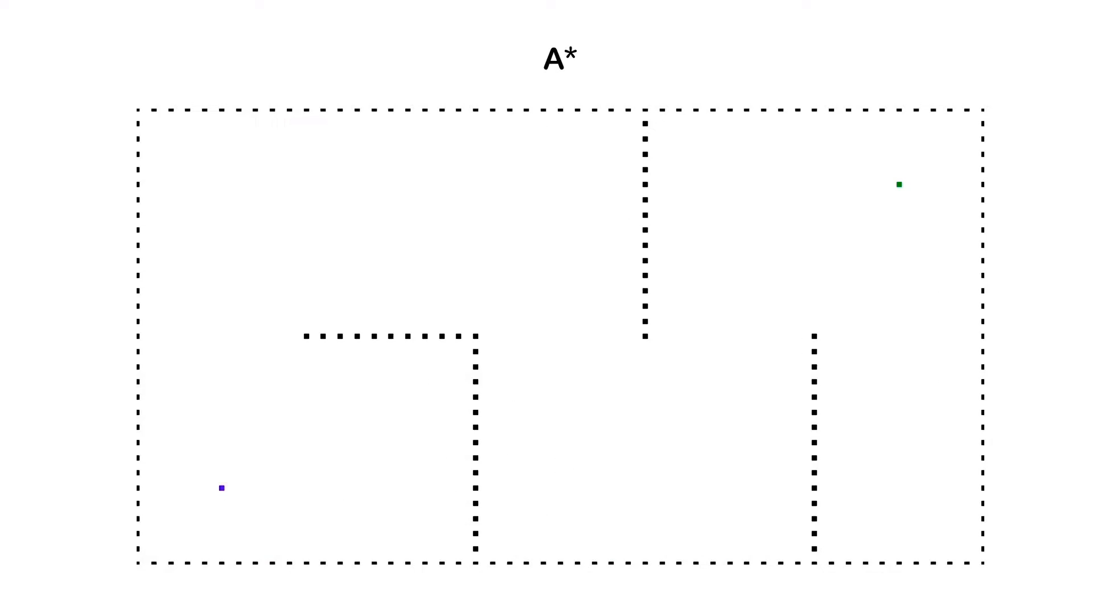
How A* works
A* works by discretizing the entire space into nodes and planning a path considering only those nodes
The cost of all the neighboring nodes are checked
Planner minimizes distance to the goal while exploring the environment
19 / 28

Slide 20
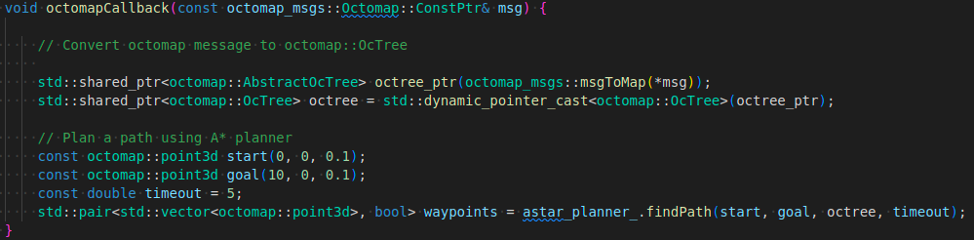
A* caller node
20 / 28
This node calls the A* path planner implemented by the MRS (Multi Robot Systems) group¹
The findPath() function starts the A* planner after taking the start and goal coordinates as well as the octomap
[1]: Tomáš Báča. MultiRotor UAV System. 2021. url: https://github.com/ctu-mrs/mrs_uav_system

Slide 21
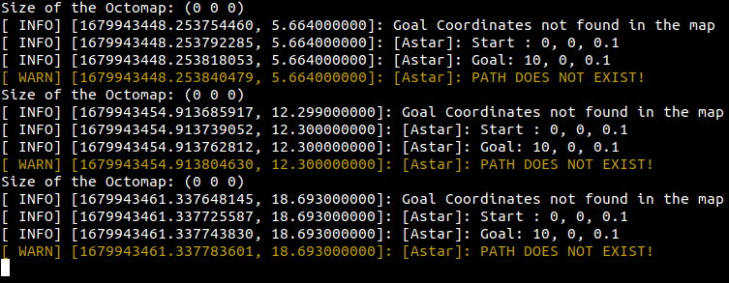
Errors encountered
The goal coordinates are never found in the octomap
Octomap size returned is 0 dimensions which is strange since the octomap data is flowing in the specified ROS topic
21 / 28

Slide 22
Path Control Module
22 / 28

Slide 23
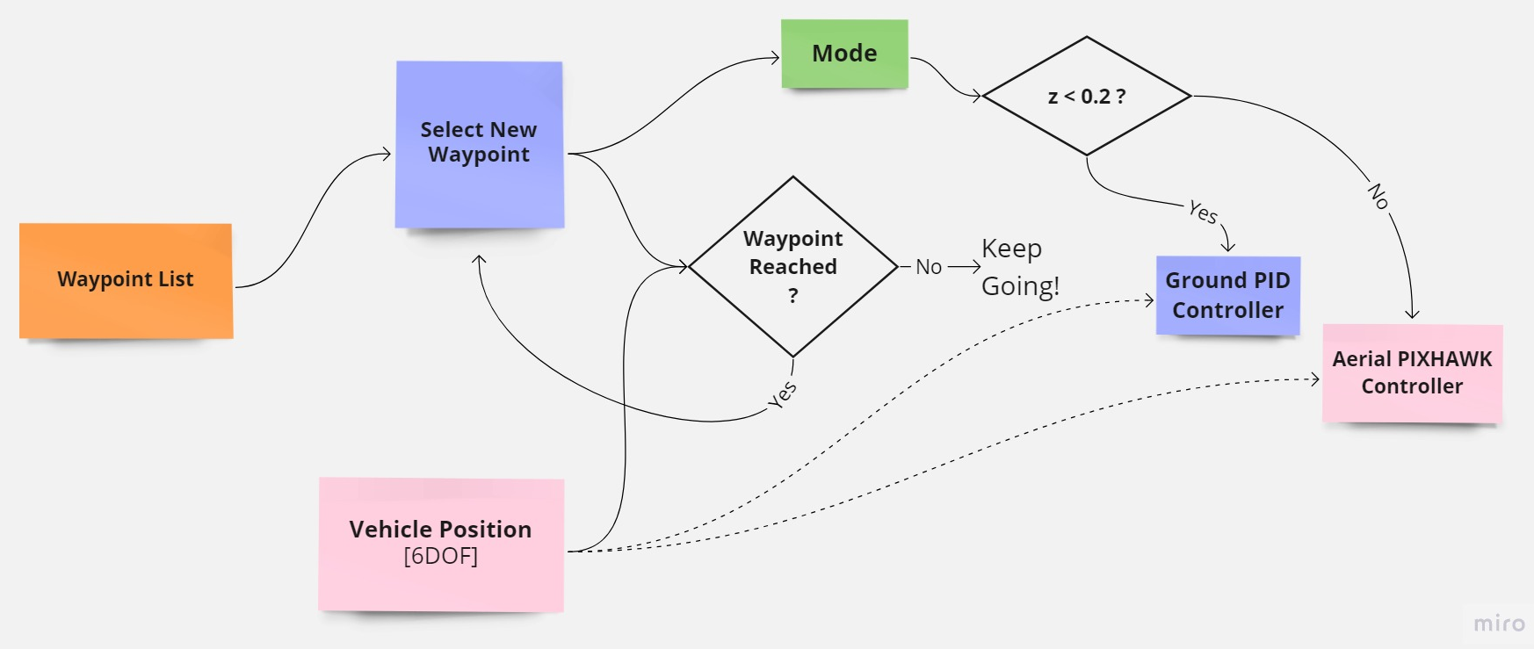
Logic Developed
23 / 28

Slide 24
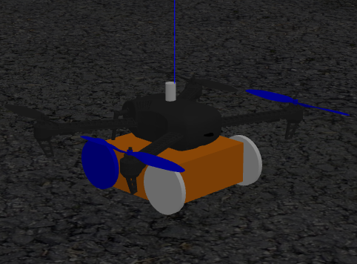
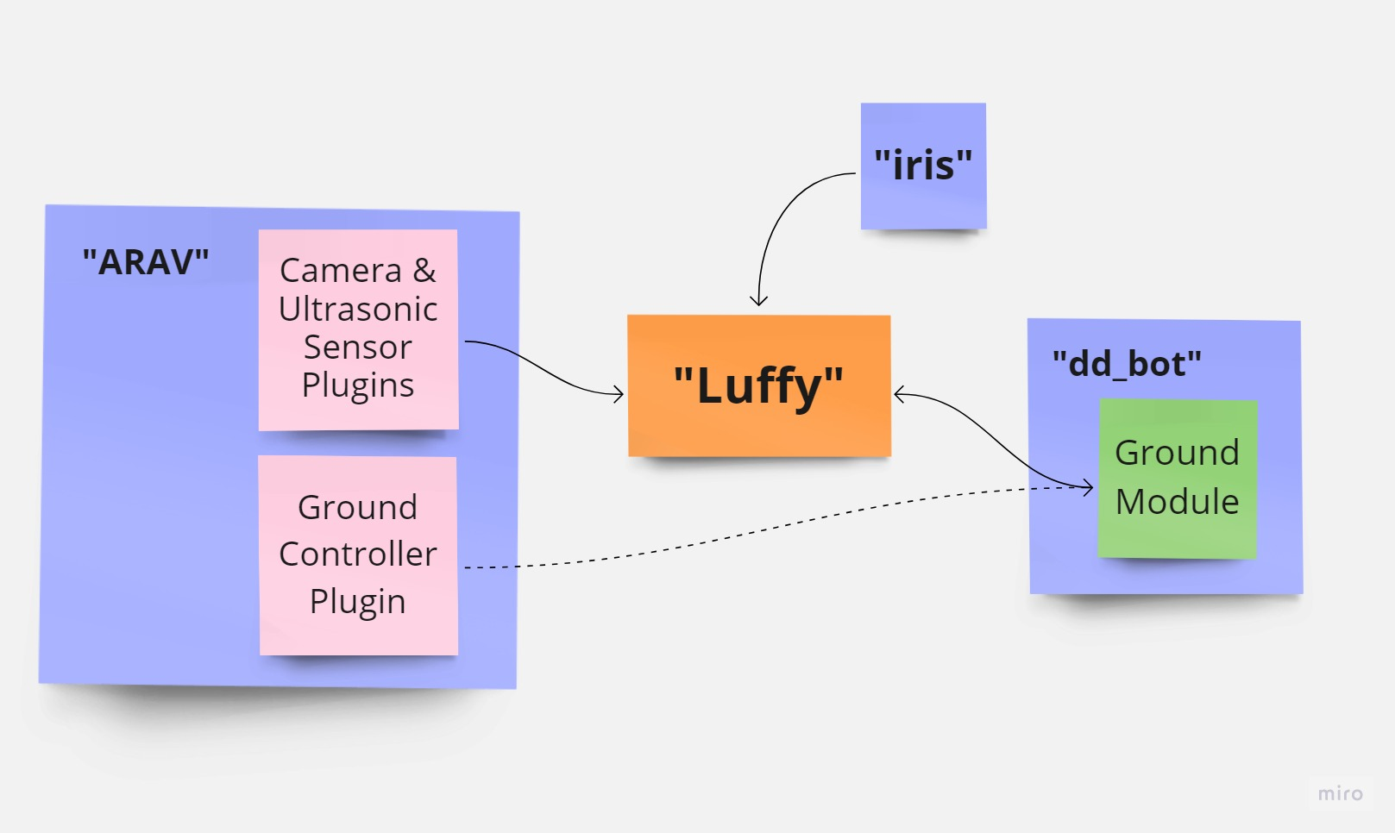
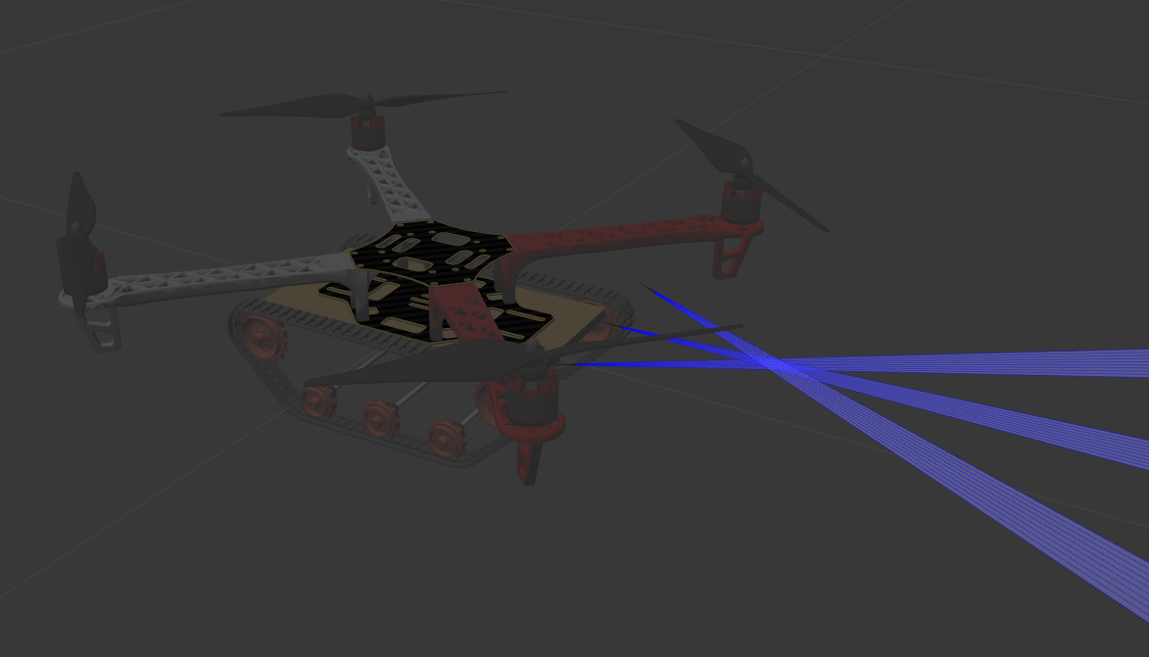
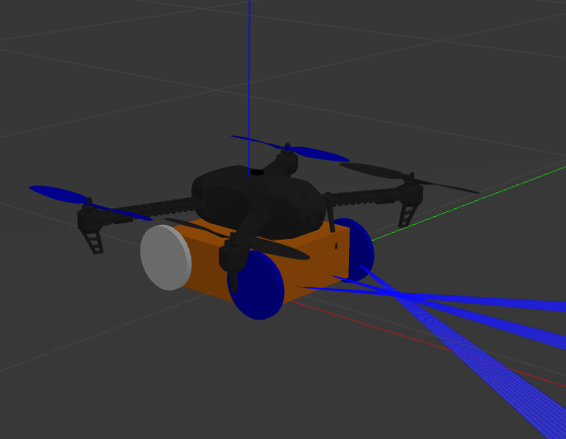
"Luffy" - Upgraded vehicle
24 / 28

Slide 25
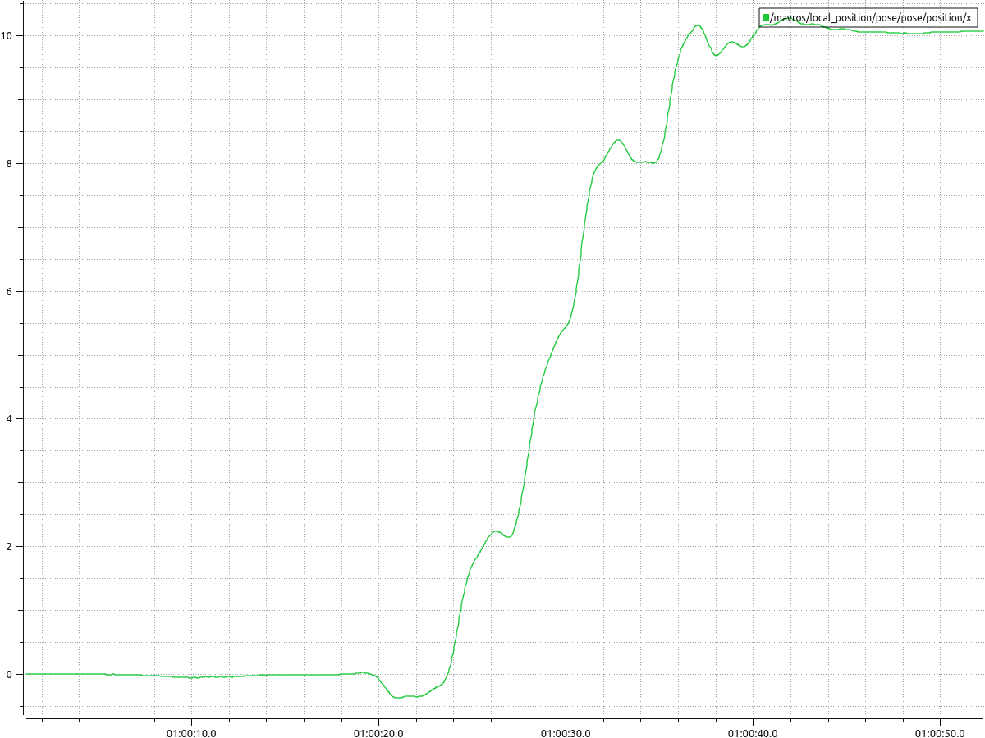
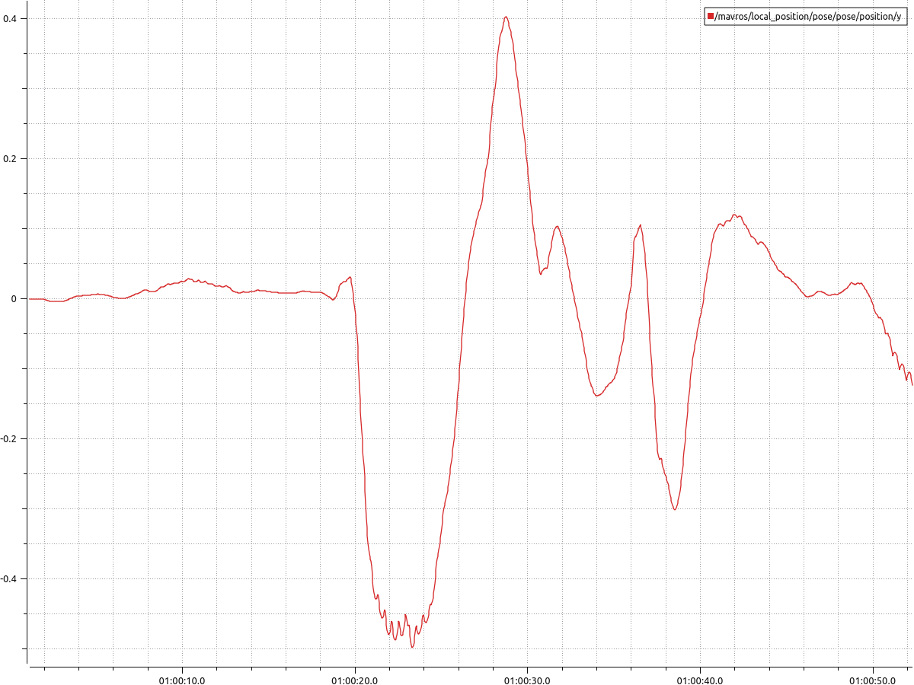
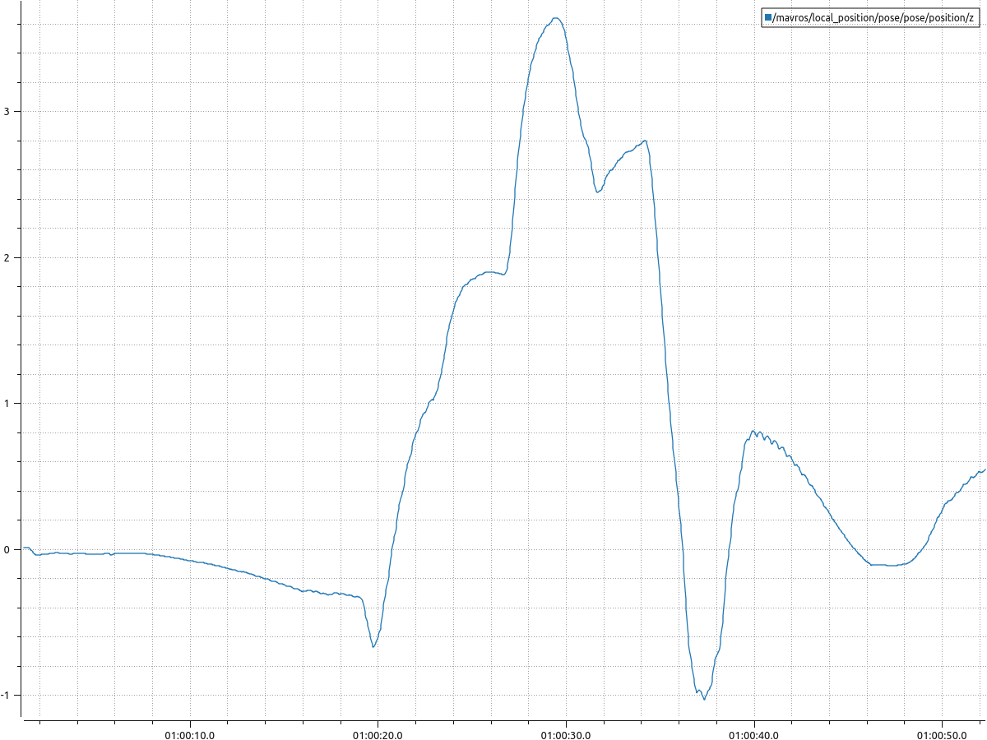
Aerial Controller Results
25 / 28
Start – (0,0,0.1), Goal - (10,0,0.1)
RRT* planner forced to create an aerial path over the wall: constrained planner space along Y-axis
Vehicle follows the path with abrupt changes in speed and position as it tracks the path waypoint-by-waypoint
X vs. Time
Y vs. Time
Z vs. Time

Slide 26
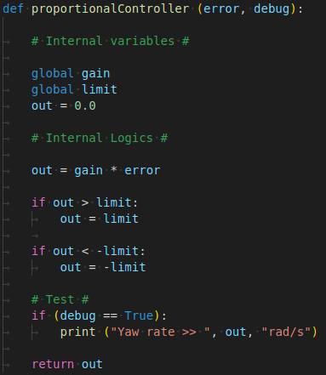
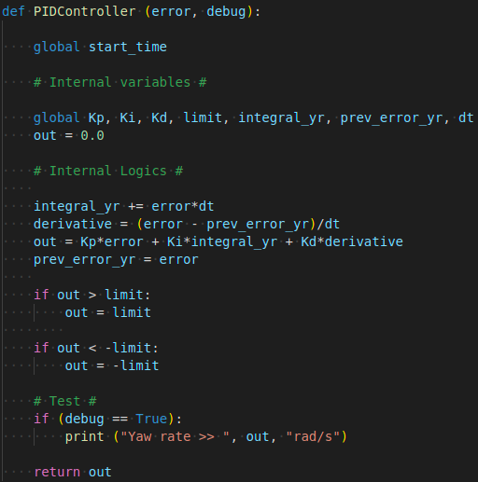
Ground Controller Development
26 / 28

Slide 27
Conclusion & Future Scope of the Project
A* error debugging is required to analyze its results
The aerial controller needs optimization to produce more fluid motion
Latency issues persist even after implementation of CUDA
The architecture can be upgraded to use SLAM as well as use in dynamic environments
The flight domain concept developed in the previous semester needs to be added
27 / 28

Slide 28
Thank you for your time!
28 / 28

Slide 29
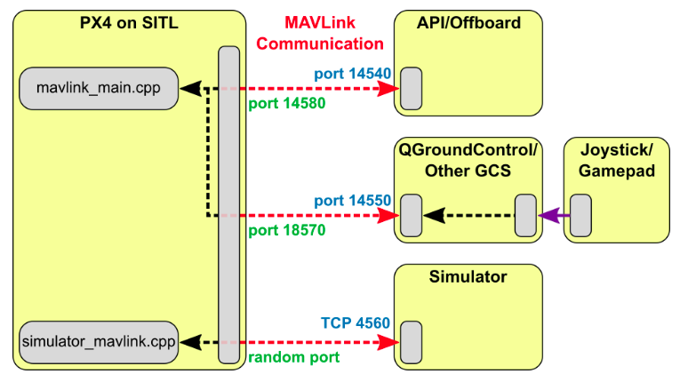

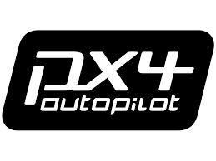

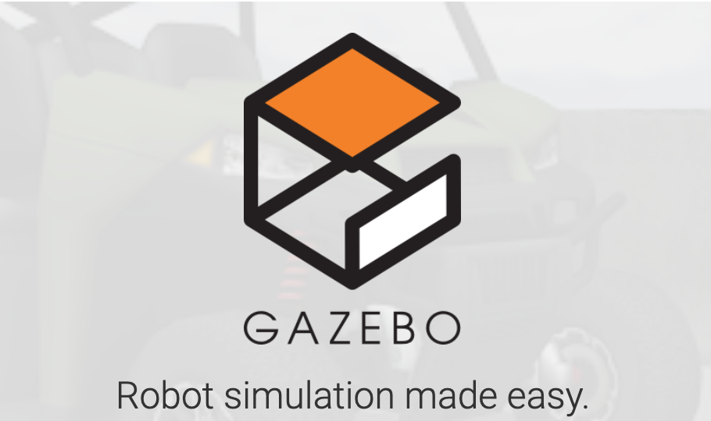
Software Architecture of the Vehicle
Notes:
PX4 communicates with Gazebo to receive sensor data from the simulated world and send motor and actuator values. It also communicates with QGC or an Offboard API like ROS to send telemetry from the simulated environment and receive commands.
MAVROS package available in ROS is used to establish communication between ROS and Pixhawk. This package enables the MAVLink communication protocol which is the supporting bridge between ROS and PX4.
MAVLINK is a communication protocol for sending and receiving messages. It standardized the types of messages that can be sent and enables bi-directional communication.
ROS - ROS has been used for developing the different modules that manage various functionalities of the vehicle, from path-planning and obstacle avoidance to high level ground and air control. ROS is an open-source development environment comprised of libraries, applications and different tools that can be utilized to develop and customize any kind of robot.
Gazebo - Gazebo is the chosen 3D simulator for testing the vehicle in simulation before the real test. It is another open-source real world simulator which can realistically simulate scenarios in indoor as well as outdoor environments. It offers a robust physics engine which makes simulating collisions easier. It can also simulate sensor feedback with noise through its various sensor models. Gazebo is also compatible with ROS which makes its utility much more convenient.
QGC - The QGC station is useful for real time monitoring and mission planning. This tool gives a comprehensive picture about the vehicle state, power and battery consumption which is useful to study the decision-making capabilities of the vehicles when it tries to conserve battery while navigating an optimum path.
PX4 - Pixhawk is the flight controller installed on the vehicle. The controller receives sensor data and adequately sends motor and actuator values.

Slide 30
Hybrid Module Optimization
Minimize power consumption while meeting deadlines
Fly inside flight domain, but drive outside it
Rate of growth of flight domain depends on user inputs:
Final coordinates
Mission time
Flight domain
Final Coordinates [x,y,z]
Sf
Vg
Switching Point
Vf
θ
Initial Position
Sg

